Slide 1
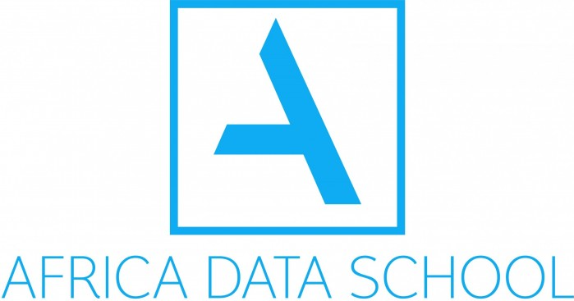

DATA SCIENCE FRAMEWORK & TOOLS

Slide 2
AGENDA
Applied Data Science
CRISP -DM Project Framework
How the World’s Biggest Companies Design Machine Learning-Powered Applications
Data tools

Slide 3

Applied Data Science
Applied data scientists
Applied scientists use Data science and ML to improve business outcomes (e.g., revenue, cost, customer experience).
The systems they build may be internal (e.g., product classification, fraud detection) or customer-facing (e.g., search, recommendations).
Outside of use-case driven applications, they might also develop internal datasets, tooling, and methodology (e.g., feature stores, package/docker templates, model testing & release checks)
Applied data scientists have higher and deep technical knowledge of how data science and its methods work.
©2021 Proprietary and Confidential. All Rights Reserved.
3

Slide 4
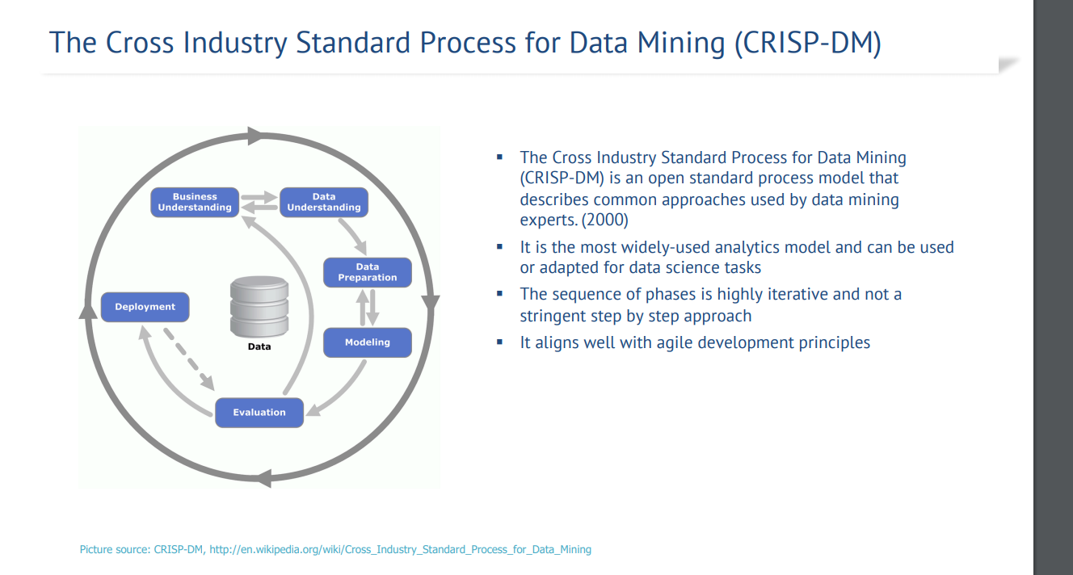

Slide 5
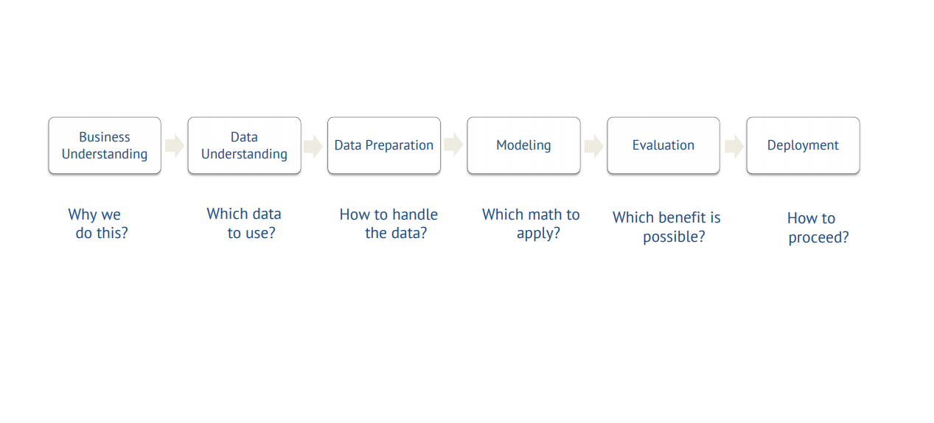
CRISP-DM breaks the process of data mining into six major phases

Slide 6
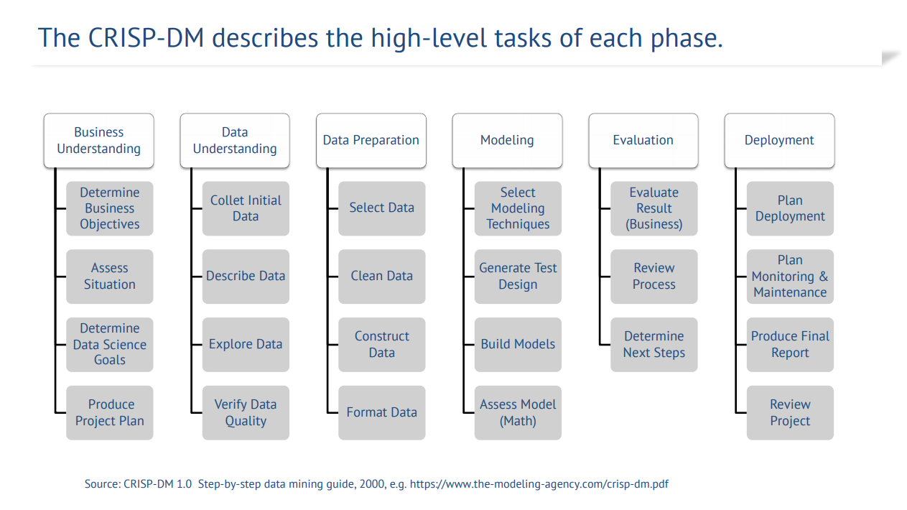

Slide 7
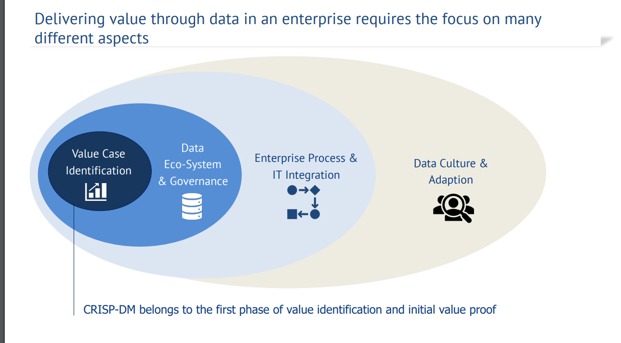

Slide 8
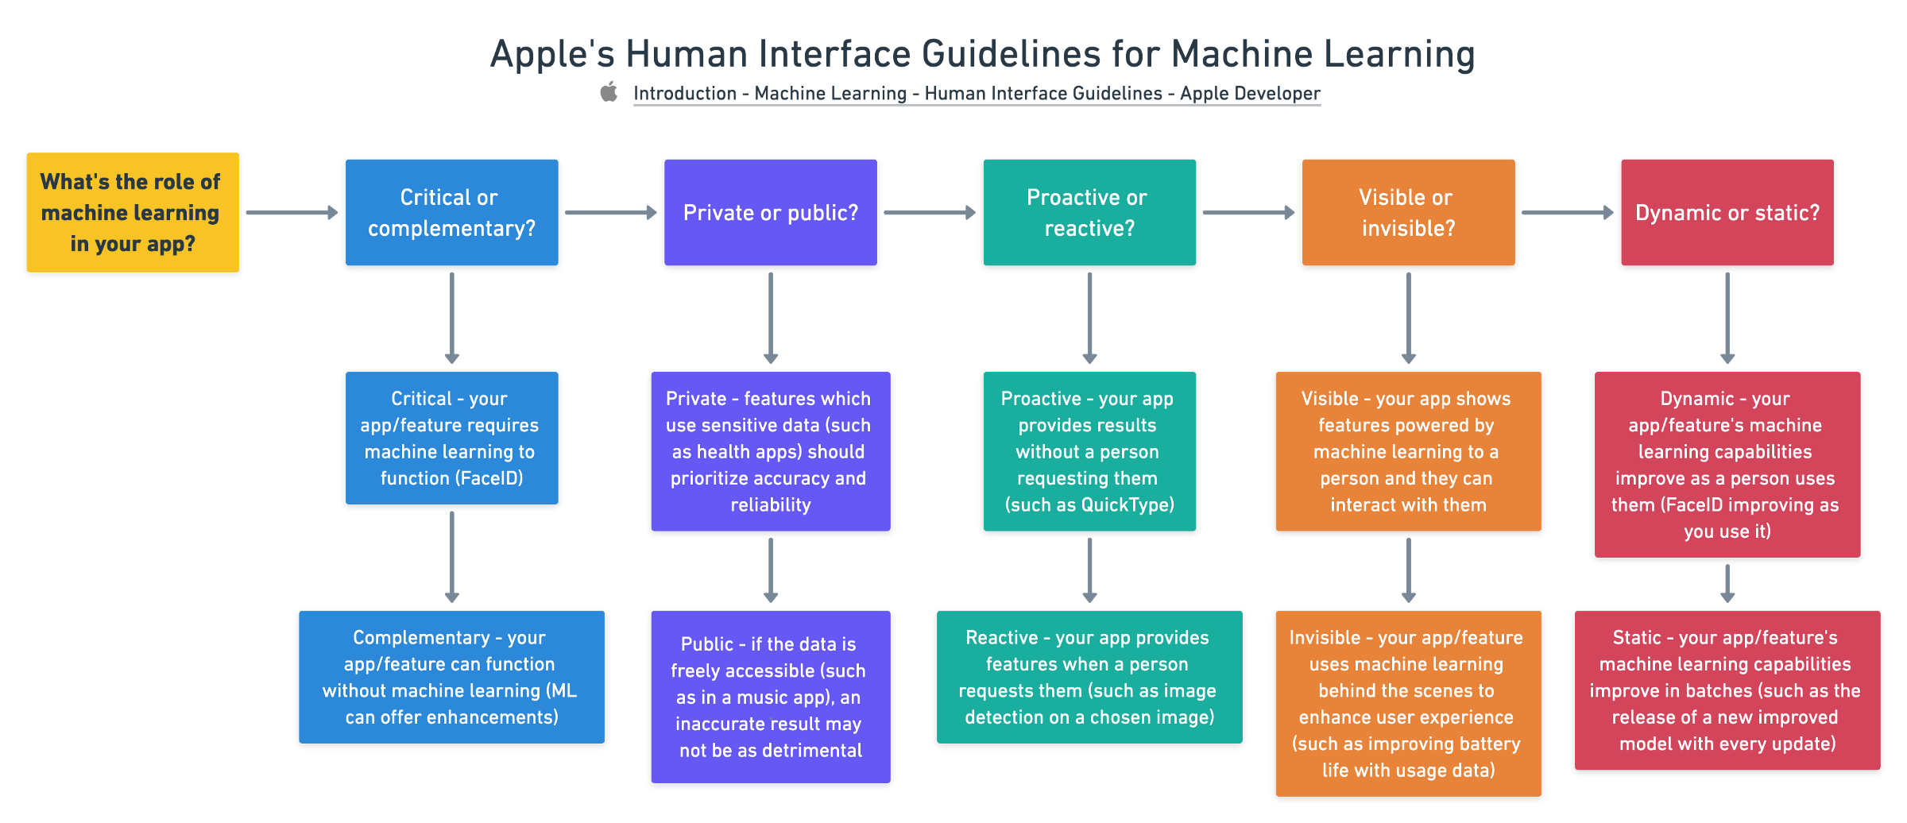
APPLE

Slide 9
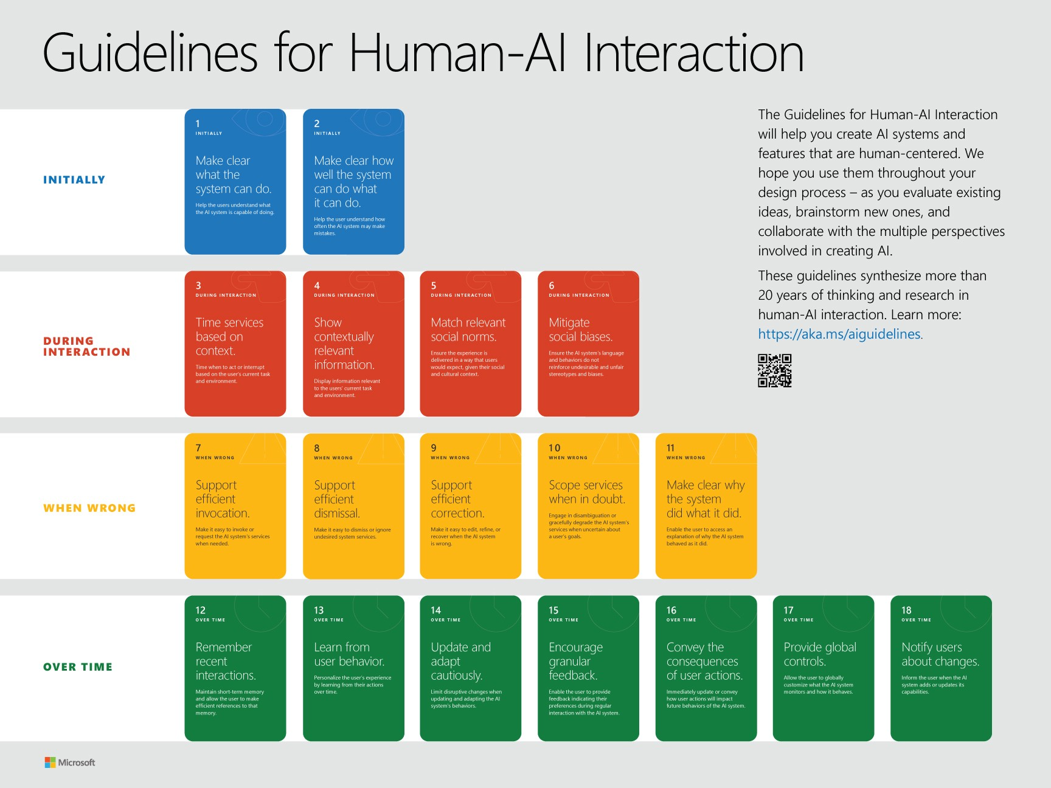
MICROSOFT

Slide 10
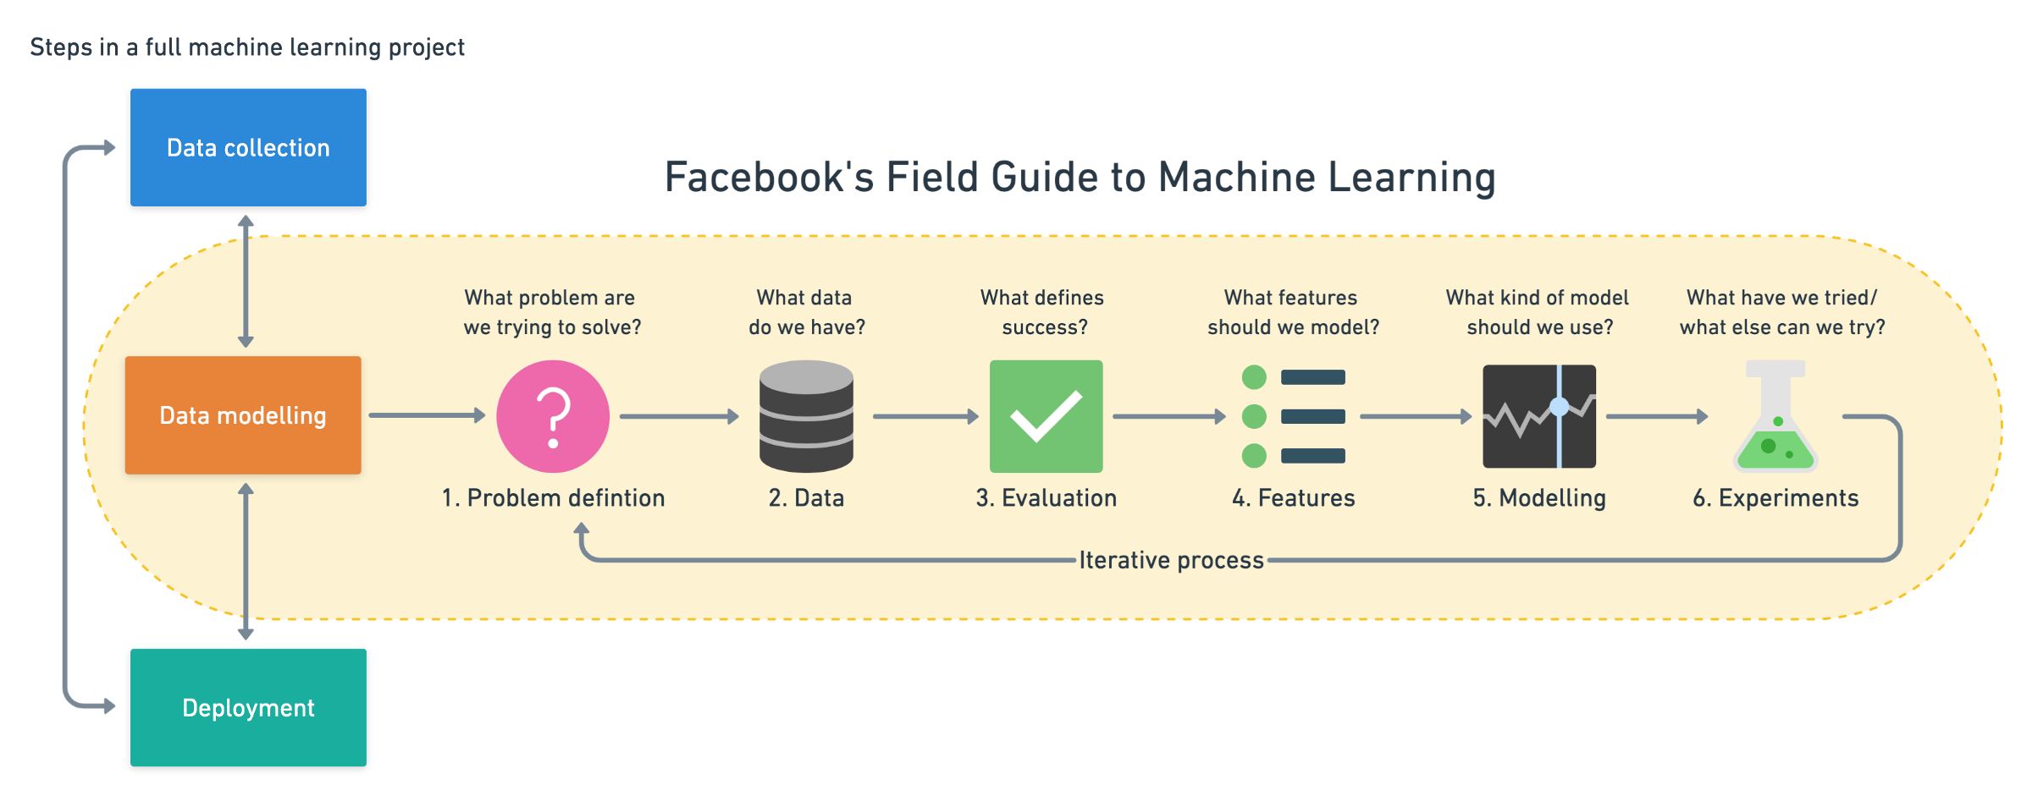
Facebook
Notes:
1)CRISP-DM: https://www.the-modeling-agency.com/crisp-dm.pdf 2)What’s the Difference Between a Data Scientist, Research Scientist, and an Applied Scientist? https://towardsdatascience.com/whats-the-difference-between-a-data-scientist-research-scientist-and-an-applied-scientist-30c04190c1fa 3)How the World’s Biggest Companies Design Machine Learning-Powered Applications https://towardsdatascience.com/how-the-worlds-biggest-companies-design-machine-learning-powered-applications-701f4114e089

Slide 11
TOOLS

Slide 12
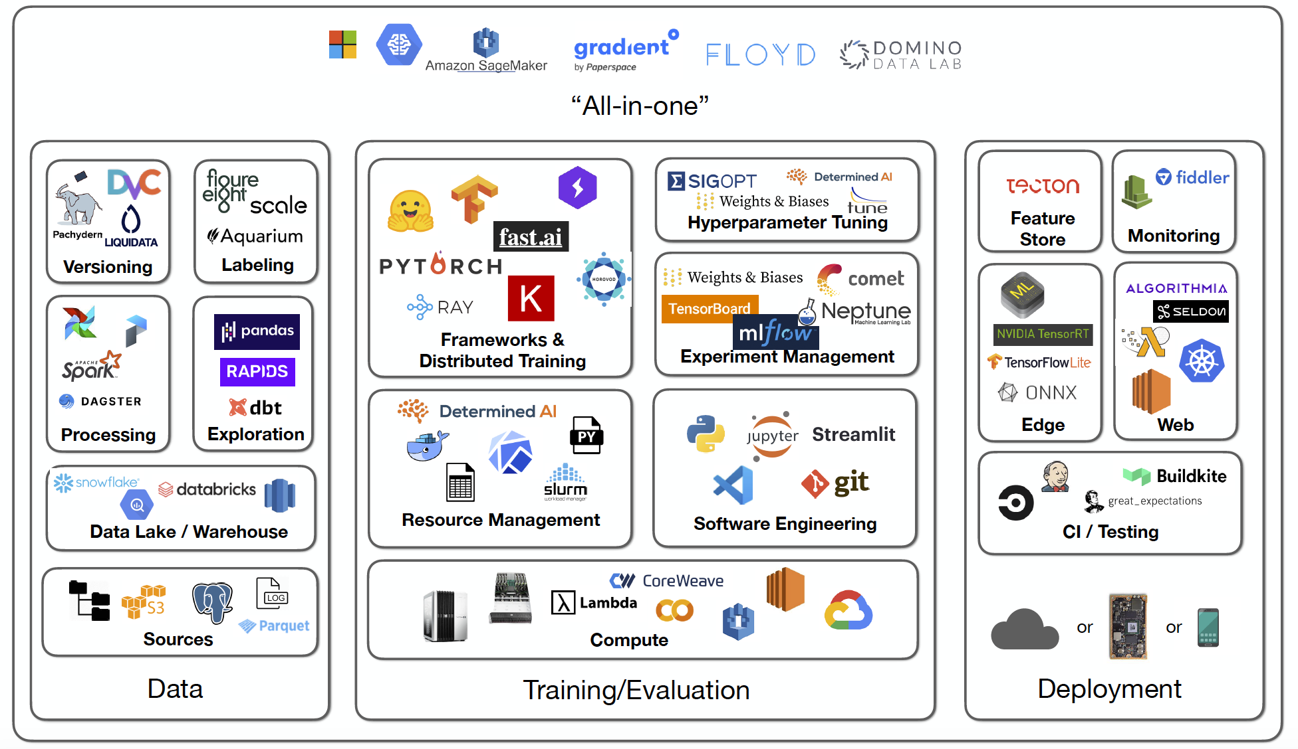

Slide 13
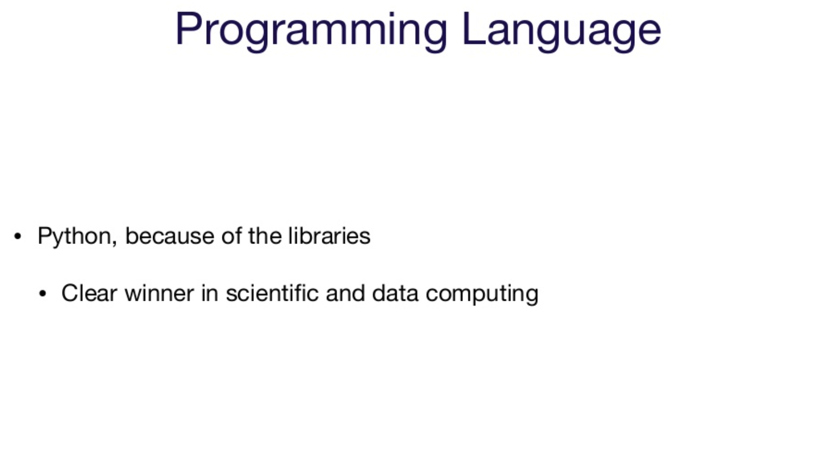

Slide 14
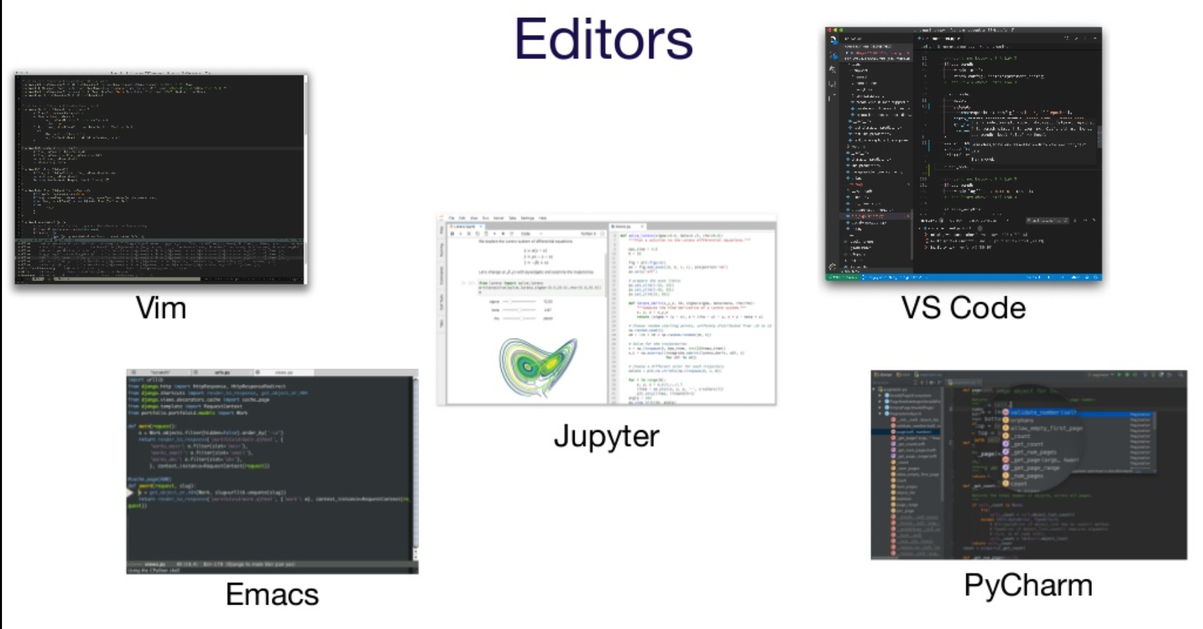
Notes:
Beyond Interactive: Notebook Innovation at Netflix https://netflixtechblog.com/notebook-innovation-591ee3221233

Slide 15
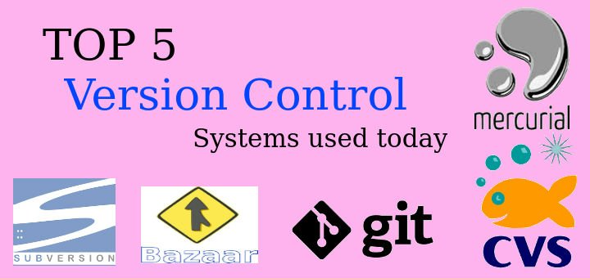
Version control (GIT & GITHUB)

Slide 16
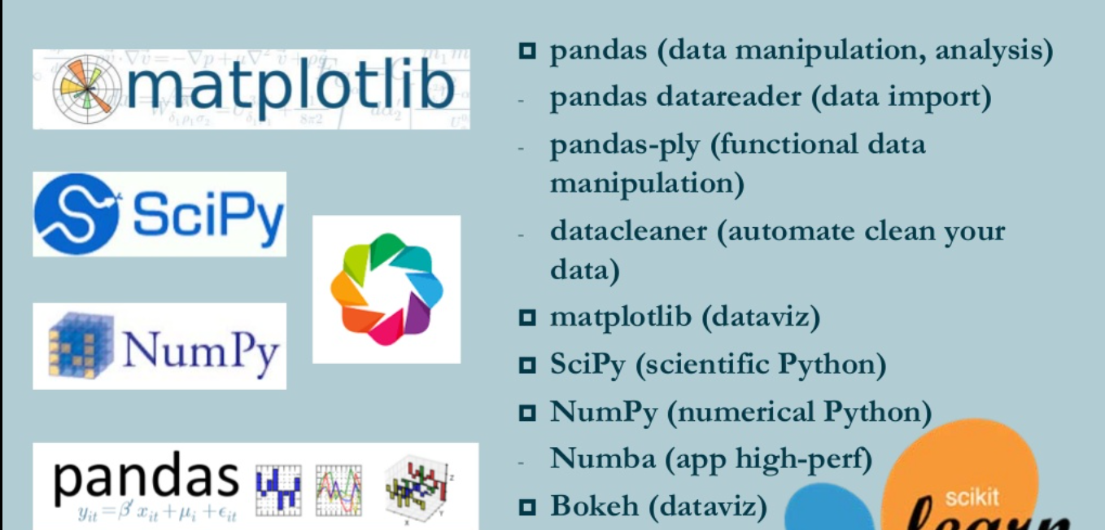
DATA ANALYSIS ( Pandas & NumPy)

Slide 17
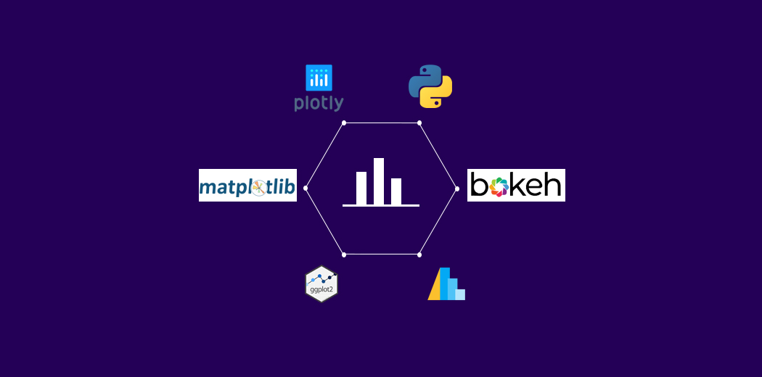
DATA VISUALIZATION (Matplotlib, Seaborn& Plotly)

Slide 18
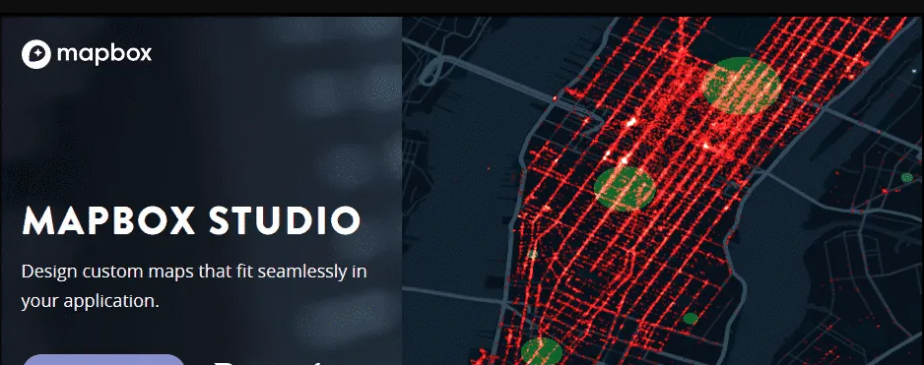
Maps & location (Mapbox)

Slide 19
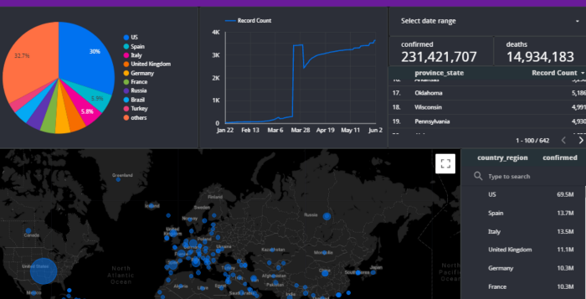
DASHBOARD (DASH & STREAMLIT)

Slide 20
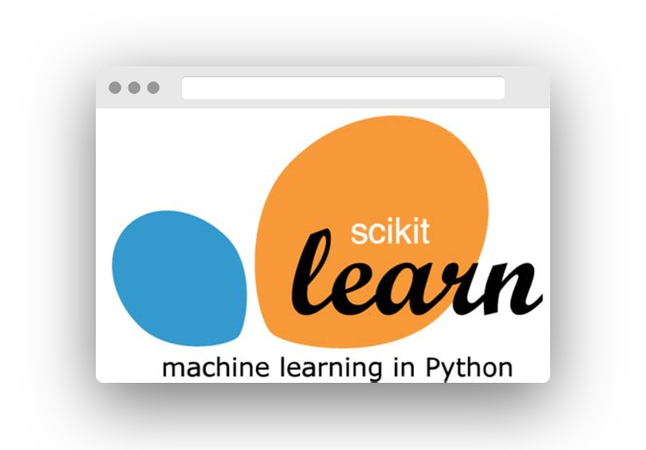
MACHINE LEARNING (Sklearn)

Slide 21
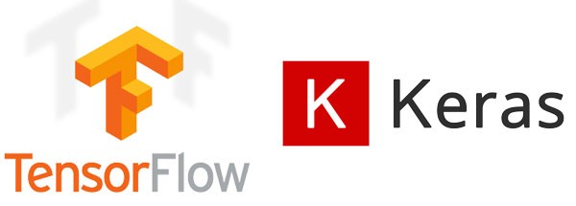
DEEP LEARNING

Slide 22

Natural language processing

Slide 23
Set up
1
Google Colabs
https://www.kdnuggets.com/2020/06/google-colab-deep-learning.html
2
Anaconda
https://docs.anaconda.com/anaconda/install/
©2021 Proprietary and Confidential. All Rights Reserved.
25

Slide 24
Read more
1)CRISP-DM:
https://www.the-modeling-agency.com/crisp-dm.pdf
2)What’s the Difference Between a Data Scientist, Research Scientist, and an Applied Scientist?
https://towardsdatascience.com/whats-the-difference-between-a-data-scientist-research-scientist-and-an-applied-scientist-30c04190c1fa
3)How the World’s Biggest Companies Design Machine Learning-Powered Applications
https://towardsdatascience.com/how-the-worlds-biggest-companies-design-machine-learning-powered-applications-701f4114e089
4) Beyond Interactive: Notebook Innovation at Netflix
https://netflixtechblog.com/notebook-innovation-591ee3221233

